Slide 1
Early Prediction of Heart Attacks using Data Mining Techniques
Data Mining Project by
Avichal Jain
Varun Gupta
Rigvita Sharma
Aastha Kataria
Aditi Agarwal
Sahil Ranadive

Slide 2
Introduction
Classification is one of the most important techniques used in data mining.
Implementation of the paper “Early Prediction of Heart Disease using Data Mining techniques” is done using a set of classification techniques namely,
Classification and Regression Tree (CART)
Iterative Dichotomized 3 (ID 3)
Random Forests Ensemble Classifier

Slide 3
DATASET AND ATTRIBUTES:
Dataset taken from: http://archive.ics.uci.edu/ml/machine-learning-databases/heart-disease/processed.cleveland.data
ATTRIBUTES:
The 14 attributes used in the dataset are:
1. Age 2. sex
3. Cp 4. trestbps
5. Chol: serum cholesterol in mg/dl 6. Fbs
7. Restecg 8. thalach
9. Exang 10. Oldpeak
11. Slope 12. ca
13. Thal 14. num (the predicted attribute)

Slide 4
Attribute Information:
The 14 attributes used in the dataset are:
1. age : age in years
2. sex : 4 sex: sex (1 = male; 0 = female)
3. Cp: chest pain type
-- Value 1: typical angina
-- Value 2: atypical angina
-- Value 3: non-anginal pain
-- Value 4: asymptomatic
4. trestbps : resting blood pressure (in mm Hg on admission to the hospital)
5. Chol: serum cholesterol in mg/dl
6. Fbs: (fasting blood sugar > 120 mg/dl) (1 = true; 0 = false)
7. Restecg: resting electrocardiographic results
-- Value 0: normal
-- Value 1: having ST-T wave abnormality (T wave inversions and/or ST elevation or depression of > 0.05 mV)
-- Value 2: showing probable or definite left ventricular hypertrophy by Estes' criteria
8. thalach: maximum heart rate achieved
9. exang: exercise induced angina (1 = yes; 0 = no)
10. Oldpeak: ST depression induced by exercise relative to rest
11. slope: the slope of the peak exercise ST segment
-- Value 1: upsloping
-- Value 2: flat
-- Value 3: downsloping
12. ca: number of major vessels (0-3) colored by fluoroscopy
13. thal: : 3 = normal; 6 = fixed defect; 7 = reversible defect
14. num (the predicted attribute): diagnosis of heart disease (angiographic disease status)
-- Value 0: < 50% diameter narrowing
-- Value 1: > 50% diameter narrowing

Slide 5
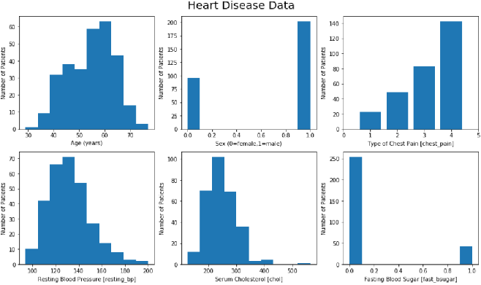

Slide 6
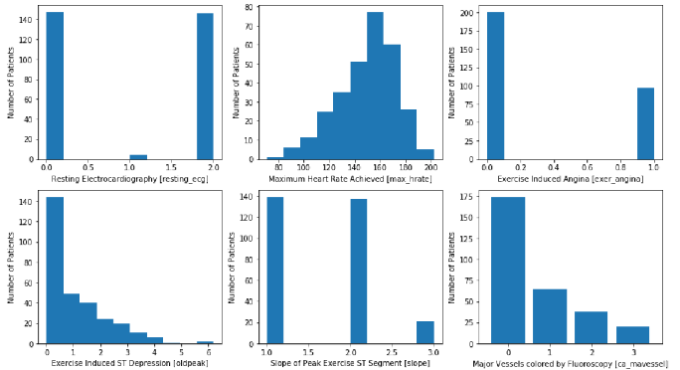

Slide 7
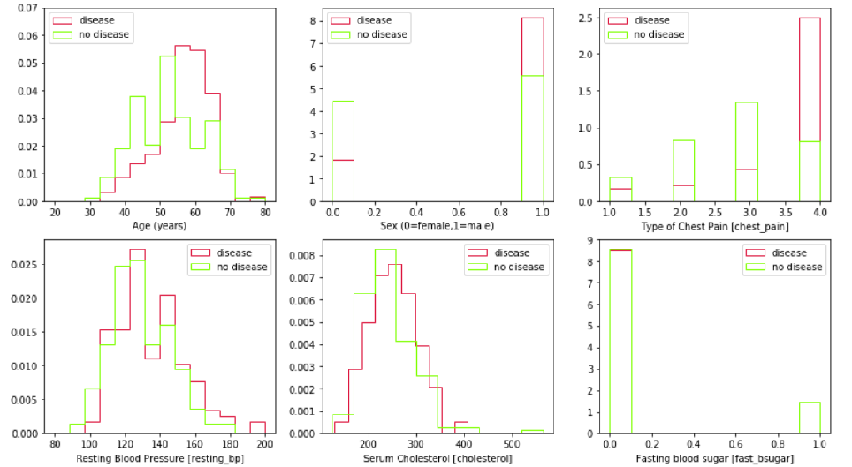

Slide 8
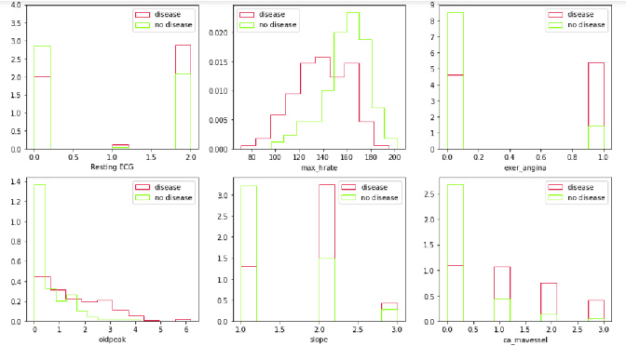

Slide 9
Preprocessing
Data Cleaning - Data is cleaned by filling the missing values using mode of the feature.
Data Transformation - Data is normalized using zero-mean normalization.
PCA(Principal Component Analysis): PCA has been used for feature selection and reducing the variance.
Constructing separate input and target lists.

Slide 11
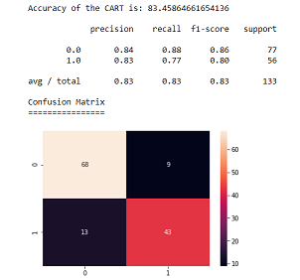
CART
CART algorithm uses decision trees to predict the target value of data.
CART uses binary trees to predict outcomes.
It used simple yes/no answers to queries on attributes to select a specific branch.
Given in the figure is the confusion matrix for
the CART algorithm along with its accuracy,
Precision, recall, f1-score, and support.

Slide 12
ID3
ID3 also uses decision tree to predict the target value.
It is used for the classification of the objects with the iterative inductive approach.
Top to down, greedy search approach is used. It’s traversing from root node to leaf nodes.
It uses information gain to help it decide which attribute goes into a decision node.It Does not handle numeric attributes and missing values.

Slide 13
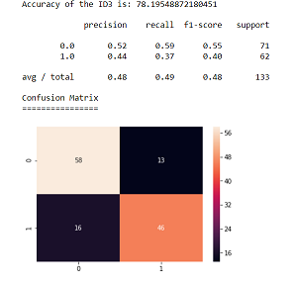
Given in the figure is the confusion matrix for
the ID3 algorithm along with its accuracy,
Precision, recall, f1-score, and support.

Slide 14
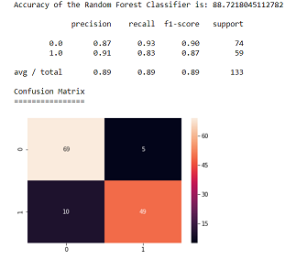
Random Forest Ensemble Classifier
Random forests adds an additional layer of randomness to bagging.
It constructs a number of decision trees at training time and outputting the class that is the average of the classes output by individual trees.
Figure shows the accuracy and confusion matrix along with the precision, recall, f1-score and support for the Random Forest ensemble classifier.

Slide 15
Algorithm Comparison
Evaluation Criteria | CART | ID3 | Random Forests
Cohen Kappa Score | 0.657 | 0.560 | 0.769
Mean Absolute Error | 0.165 | 0.218 | 0.112
Root Mean Squared Error | 0.406 | 0.466 | 0.335
An analysis of the Kappa Score, Mean Absolute Error and the Root Mean Squared Error show that Random Forest Ensemble Classifier gives the optimum result since the error in this technique is the least.

Slide 16
Future Work
There are many possible improvements that could be explored to improve the scalability and accuracy of this prediction system. Due to time limitation, the following research work needs to be performed in the future.
To make use of testing different discretization techniques, multiple classifiers Voting technique and different Decision tree types like information gain,gain ratio and Gini index. Eg. Experiment need to perform on use of Equal Frequency Discretization Gain Ratio Decision Trees by applying nine Voting scheme in order to enhance the accuracy and performance of diagnosis of heart disease.
This report proposes a framework using combinations of CART , ID and Random Forest to arrive at an accurate prediction of heart disease. Further work involves development of system using the mentioned methodology to be use for checking the imbalance with other data mining models.
To explore different rules such as Association, Clustering, K-means etc for better efficiency and ease of simplicity.
Continuous data instead of categorical data can also be analysed in further study for better results. Also, text mining, image processing and other such techniques can also be used to include unstructured healthcare data in this study and hence enhance the dataset used.

Slide 17
Conclusion
The best algorithm based on the patient’s data is Random Forest Classification with accuracy of 88.72% and lowest average error at 0.112 compared to others.
Average error for ID3 and CART is 0.218 and 0.165 respectively.
Out of the two classifiers CART(83.45%) has more accuracy than ID3(78.14%).

Slide 18
Thank You.

